Slide 1
Secure Response (SR)
Supervisor
Prof. Sulaiman Alsuhiban
Sulaiman aldubaykhi

Slide 2
Why do we need a Secure Response?

Slide 3
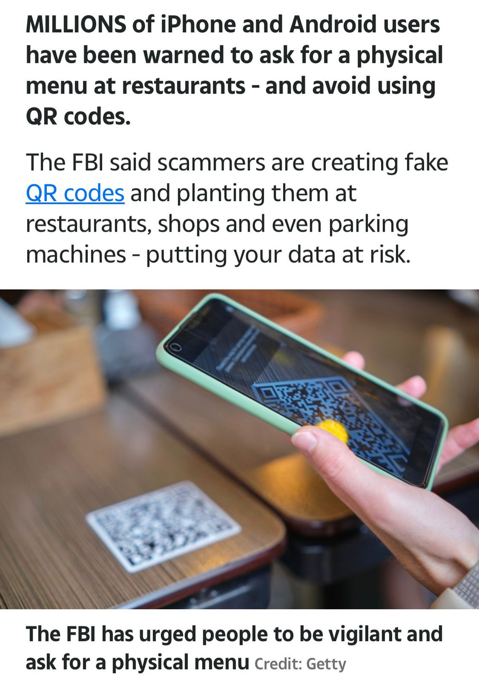
FBI warning

Slide 4

The Problem

Slide 5
The Problem
Attackers take advantage of the increased use of QR codes to launch different attacks.
Phishing
Malware

Slide 6
Solution

Slide 7
Solution
The solution to this problem is to create a reader that scans the QR code, to check if it is trusted or not, as it depends on machine learning.

Slide 8
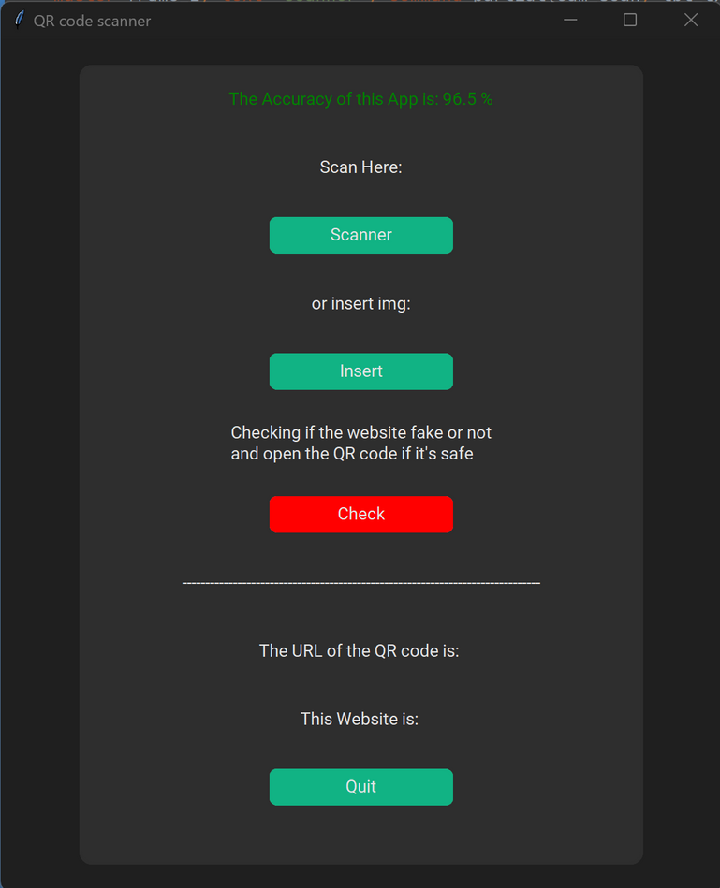
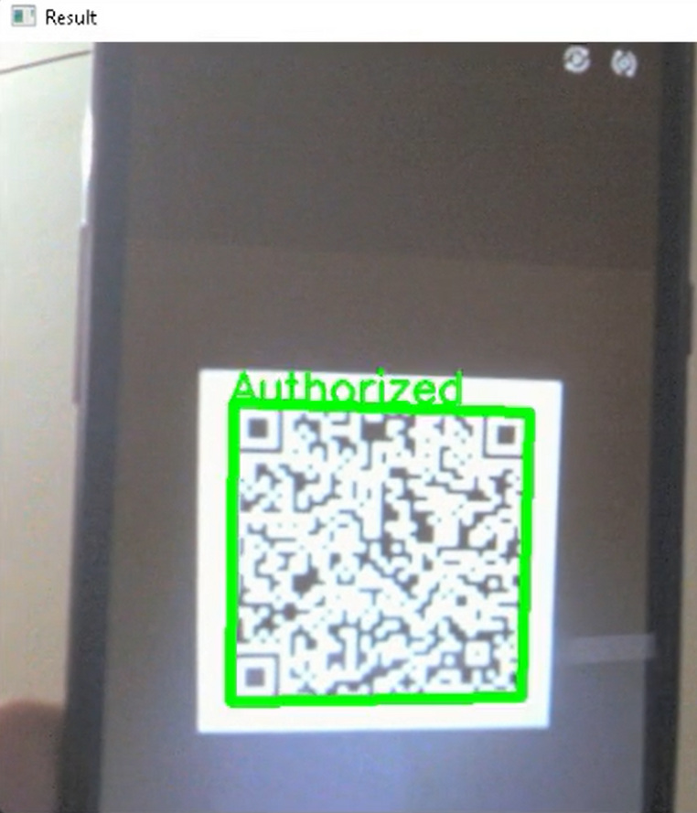
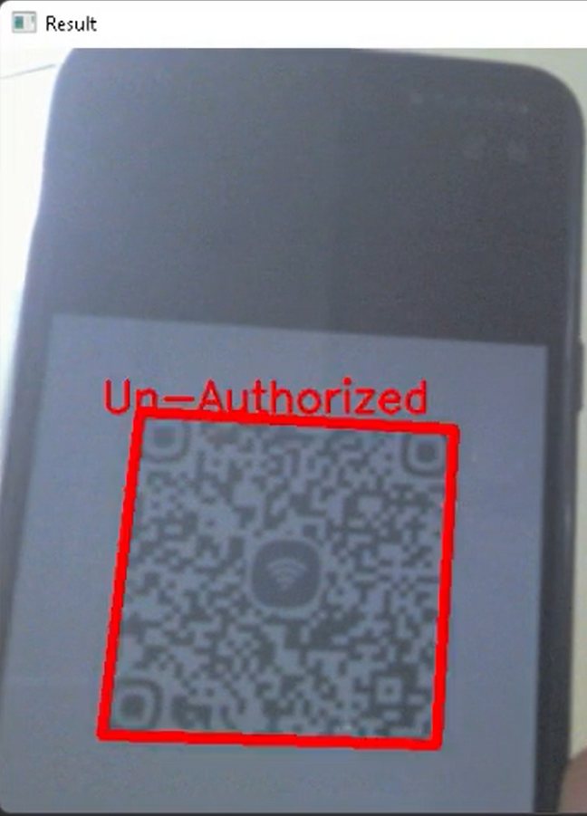
Solution

Slide 9
Beneficiaries and competitors

Slide 10
Technology companies
Security software companies
Governmental entities

Slide 11
Cost

Slide 13
Project Financing

Slide 14
The project's funding source is booststrapping

Slide 15
Team

Slide 16
سليمان الدبيخي - CEO
مجد الزهراني - CTO
مدى الباني - CPO
اعتدال الرويلي - COO
ايناس الصحفي - sales

Slide 17
Thanks

